Slide 1
ELEC3844 Engineering Management and Society SWOT Analysis
Dr. Wilton Fok

Slide 2
Contents
SWOT Analysis
Internal and external factors
Application example
4 scenarios in SWOT
Matching and converting
Applying SWOT analysis to study the competitive industries in Hong Kong

Slide 3
SWOT Analysis
A SWOT analysis is a strategic planning tool used to evaluate the followings in a project or business
Strengths,
Weaknesses,
Opportunities, and
Threats
It involves specifying the objective and then identifying the internal and external factors that are favorable and unfavorable to achieve that objective.

Slide 4
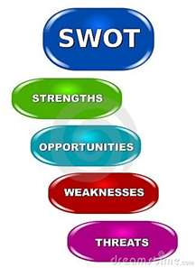
SWOT Analysis
Strengths
characteristics of the business, or project team that give it an advantage over others
Weaknesses
(or Limitations): are characteristics that place the team at a disadvantage relative to others
Opportunities
external chances to improve performance (e.g. make greater profits) in the environment
Threats
external elements in the environment that could cause trouble for the business or project

Slide 5
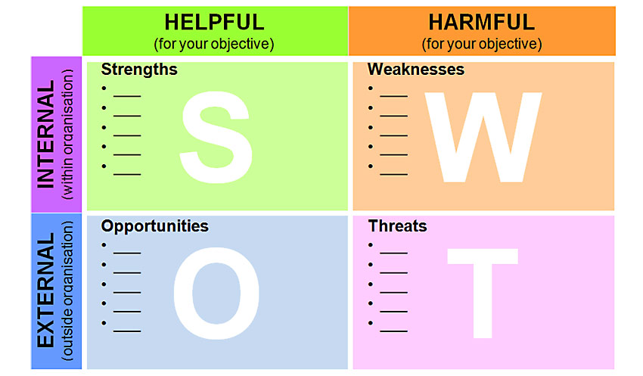
Internal and external factors
Aim SWOT analysis: to identify the key internal and external factors that are important to achieving the objective.
Internal factors – The strengths and weaknesses internal to the organization.
External factors – The opportunities and threats presented by the external environment to the organization.

Slide 6
Internal factors
The internal factors are the strengths or weaknesses depending upon their effect on the organization's objectives.
What may represent strengths with respect to one objective may be weaknesses for another objective.
E.g. 4Ps in marketing; personnel, finance, manufacturing capabilities…etc.

Slide 7
External factors
Factors belong the control by the organization be may affect the decision
E.g.
macroeconomic matters,
technological change,
legislation, and
socio-cultural changes,
marketplace or competitive position

Slide 8
Use of SWOT analysis
SWOT analysis may be used by any organization when a desired objective has been defined.
E.g. non-profit organizations, governmental units,
Student society, Individuals
Use for
decision-making
pre-crisis planning and
preventive crisis management
creating a recommendation during a viability study/survey.

Slide 9
SWOT analysis for Marketing
To build detailed profiles of each competitor in the market
focusing especially on their relative competitive strengths and weaknesses using SWOT analysis.
Examine their cost structure, sources of profits, resources and competencies, competitive positioning and product differentiation, degree of vertical integration, historical responses to industry developments, and other factors.
To perform environmental scanning and competitive intelligence processes to help identify trends and inform the company's marketing analysis.

Slide 10
SWOT analysis for Marketing
How? Through marketing researches:
Qualitative marketing research, such as focus groups
Quantitative marketing research, such as statistical surveys
Experimental techniques such as test markets
Observational techniques

Slide 11

Example
The Hong Kong Institution of Engineers also uses SWOT analysis for their development plan

Slide 12
e.g. SWOT for HKIE: Strengths
For reference only
1. Internationally recognized qualifications
2. Single Institution with multi-disciplines
3. Empowered by Ordinance, with long history, well established and financially strong with own premises
4. Appreciable/increasing media coverage
5. Continuously establishing new disciplines to cater most members from different engineering industries
6. Strong connection with overseas professional engineering institutions
7. Well established membership system, including Scheme “A” training for emerging engineers
8. Increased initiatives for development in professionalism, e.g. Veneree Club, President’s Protégé Scheme and School Ambassador Programme

Slide 13
e.g. SWOT for HKIE : Opportunities
For reference only
1. Ten Major Infrastructure Projects produce more employment opportunities for the industry and drive the demand for engineering graduates. The number of members of the Institution might increase because of this
2. The HKIE may utilise the blooming atmosphere stimulated by the Ten Major Infrastructure Projects to promote the engineering profession to the public and attract more attention to the profession itself
3. Enhancing mutual recognition agreement with engineering institutions in the Mainland may help to bring more opportunities to Hong Kong engineers, as well as promote the HKIE to the Mainland engineers
4. Engineering industry can leverage on its unique advantages and functions through the National 12th Five-Year Plan to develop the six industries where Hong Kong enjoys competitive advantages
5. Launching of new regulations (e.g. Buildings Energy Efficiency Ordinance) can increase the demand for registered professionals
6. The HKIE can enhance its visibility to community through organising international conferences and public engagement programmes

Slide 14
e.g. SWOT for HKIE : Weaknesses
For reference only
1. Less recognition received from the public on the engineering industry
2. The relatively more stringent requirements on professional review discourage some experienced engineers from choosing to be registered engineers in the HKIE. Instead, they may choose to charter at some overseas institutions
3. The mechanism of the HKIE spokesmen to respond to queries from the media and the public on specific engineering topics is less effective
4. The engineering profession is not well understood by the public
5. Inadequate and insufficient large-scale promotion activities for the HKIE

Slide 15
e.g. SWOT for HKIE : Threats
For reference only
1. Talented youths choose to study in business but not in engineering, which may hinder the development of the Institution as well as the industry. Social status of engineers is less attractive than other professionals
2. Potential difficulty in sustaining the growth of membership in the long term despite the bloom of new-comers due to the Ten Major Infrastructure Projects implemented in recent years
3. Fluctuating demand of industry impairs the career prospect of professionals
4. Limitation of available conference rooms at the HKIE Headquarters makes it difficult for Divisions/ Committees to organise activities/ seminars
5. Expansion of other engineering institution disciplines in Hong Kong may dilute the role of the HKIE and cast threat to membership

Slide 16


Discussion:
Download and install “iClass - Interactive Class on Cloud” from Appstore”, Setting> School: [HKU]
For other devices: hku.iclass.hk
Login using your portal ID (Login through HKU Portal)
Join the course: GR5182
Click the question “Use SWOT analysis to analysis your start-up idea”
Wipe the screen (Left and right) for next category
Submit word and click submit

Slide 17
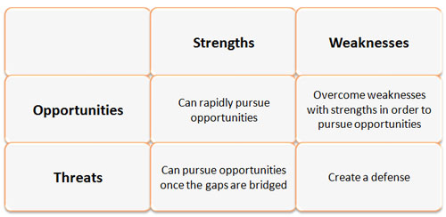
4 scenarios in SWOT
There are 4 scenarios:
Strengths and Opportunities
Weaknesses and Threats
Strengths and Weaknesses
Opportunities and Threats
What/how should we do/react in different factors?
S-O
W-O
S-T
W-T

Slide 18
S-O: Helpful
Strengths and Opportunities
How do you leverage your strengths to benefit from opportunities?
W-O
S-T
W-T

Slide 19
W-O: Catch the opportunity
Weakness and Opportunities
How do you ensure your weaknesses will not stop you from opportunities?
S-O
S-T
W-T

Slide 20
S-T: Avoid the threats
Strengths and Threats
How do you use your strengths to minimize the impact of treats?
S-O
W-O
W-T

Slide 21
W-T: Harmful
Weaknesses and Threats
How will you fix weaknesses that can make treats have a real impact?
S-O
W-O
S-T

Slide 22
Summary of the suggestion actions for different scenario

Slide 23
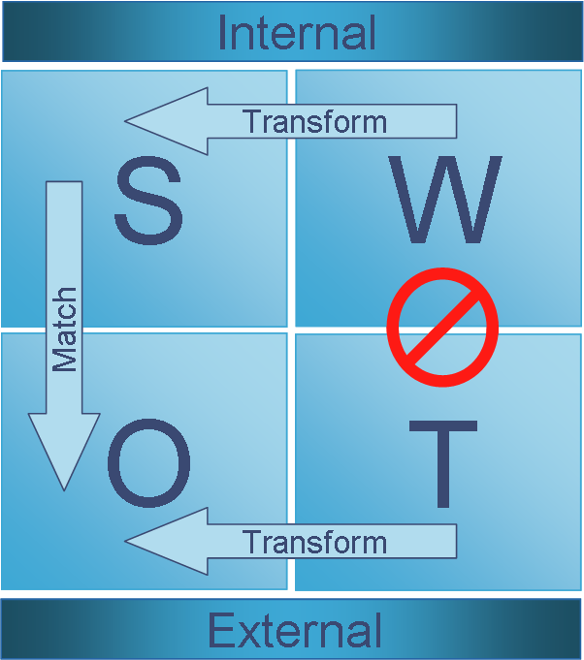
Matching and converting
The SWOT analysis is used to match strengths to opportunities and convert weaknesses or threats into strengths or opportunities:
Matching
to find competitive advantages by matching the strengths to opportunities.
Converting (Transforming)
to apply conversion strategies to convert weaknesses or threats into strengths or opportunities. E.g. to find new markets.
Avoid
If the threats or weaknesses cannot be converted a company should try to minimize or avoid them.

Slide 24
Tips of using SWOT analysis
Weak opportunities may appear to balance strong threats.
A SWOT item that produces valuable strategies is important.
A SWOT item that generates no strategies is not important.

